Slide 1



AGILE model

Slide 2

AGENDA
AGILE MODEL
ROLES IN AGILE METHODOLOGY
ADVANTAGES AND DISADVANTAGES OF AGILE METHODOLOGY
AGILE MANIFESTO
PRINCIPLES OF AGILE MANIFESTO
AGILE CHARACTERISTIC
SCRUM
KANBAN
PRINCIPLE OF KANBAN
EXTREME PROGRAMMING
VALUES OF EXTREME PROGRAMMING
PRINCIPLE OF EXTREME PROGRAMMING
AGILE METHODOLOGY

Slide 3

AGILE MODEL

Slide 4
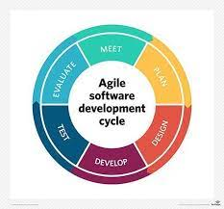
AGILE
Our Agile is designed for beginners and professionals.
Agile is an iterative approach of software development methodology using short iterations of 1 to 4 weeks.
Using Agile methodology, the software is distributed with fastest and fewer changes.
Agile software development -- also referred to simply as Agile -- is a type of development methodology that anticipates the need for flexibility and applies a level of pragmatism to the delivery of the finished product.
This is known as agile software development.

Slide 5
AGILE METHODOLOGY

Slide 6
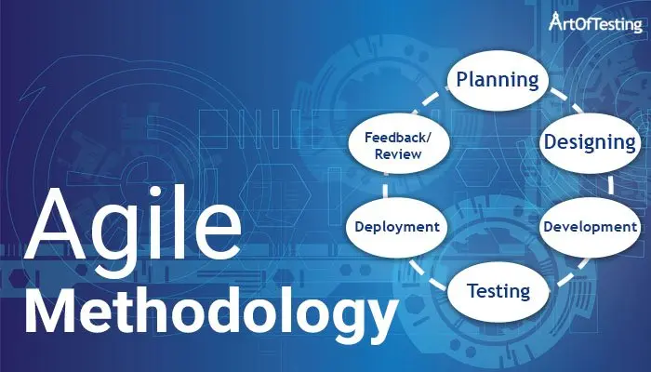
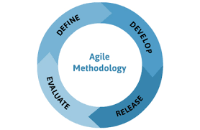
AGILE METHODOLOGY
An agile methodology is an iterative approach to software development.
Each iteration of agile methodology takes a short time interval of 1 to 4 weeks.
The agile development process is aligned to deliver the changing business requirement.
It distributes the software with faster and fewer changes.
The single-phase software development takes 6 to 18 months.
In single-phase development, all the requirement gathering and risks management factors are predicted initially.
The agile software development process frequently takes the feedback of workable product.
The workable product is delivered within 1 to 4 weeks of iteration.

Slide 7
ROLES IN AGILE METHODOLOGY

Slide 8
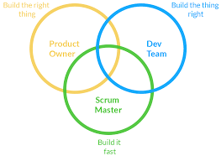
ROLES IN AGILE METHODOLOGY
There are two different roles in a Agile methodology. They are:
Scrum Master
Product Owner

Slide 9
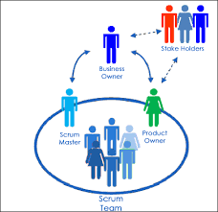
Scrum Master:
The Scrum Master is a team leader and facility provider who helps the team member to follow agile practices, so that the team member meets their commitments and customers requirements. The scrum master plays the following responsibilities:
They enable the close co-operation between all the roles and functions.
They remove all the blocks which occur.
They safeguard the team from any disturbances.
They work with the organization to track the progress and processes of the company.
They ensure that Agile Inspect & Adapt processes are leveraged correctly which includes
Planned meetings
Daily stand-ups
Demo
Review
Retrospective meetings, and
Facilitate team meetings and decision-making process.

Slide 10
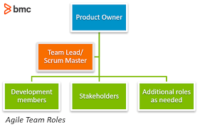
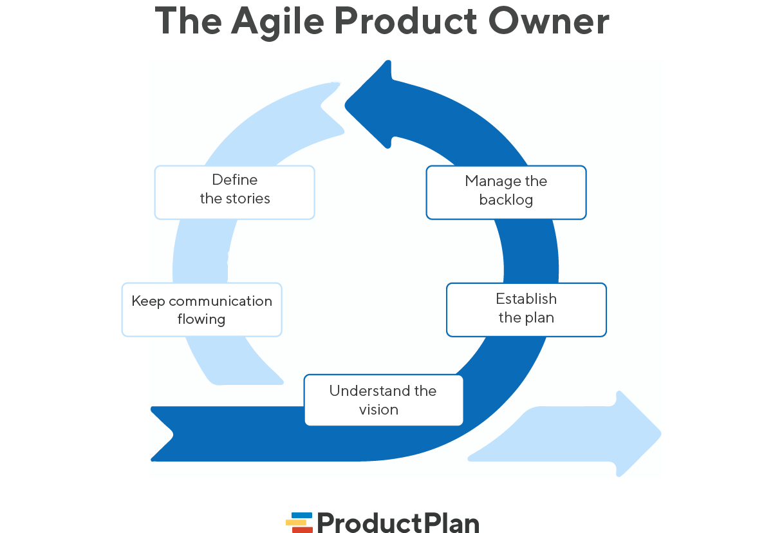
Product Owner:
The Product Owner is one who runs the product from a business perspective. The Product Owner plays the following responsibilities:
He defines the requirements and prioritizes their values.
He sets the release date and contents.
He takes an active role in iteration and releasing planning meetings.
He ensures that the team is working on the most valued requirement.
He represents the voice of the customer.
He accepts the user stories that meet the definition of done and defined acceptance criteria.

Slide 11


Slide 12
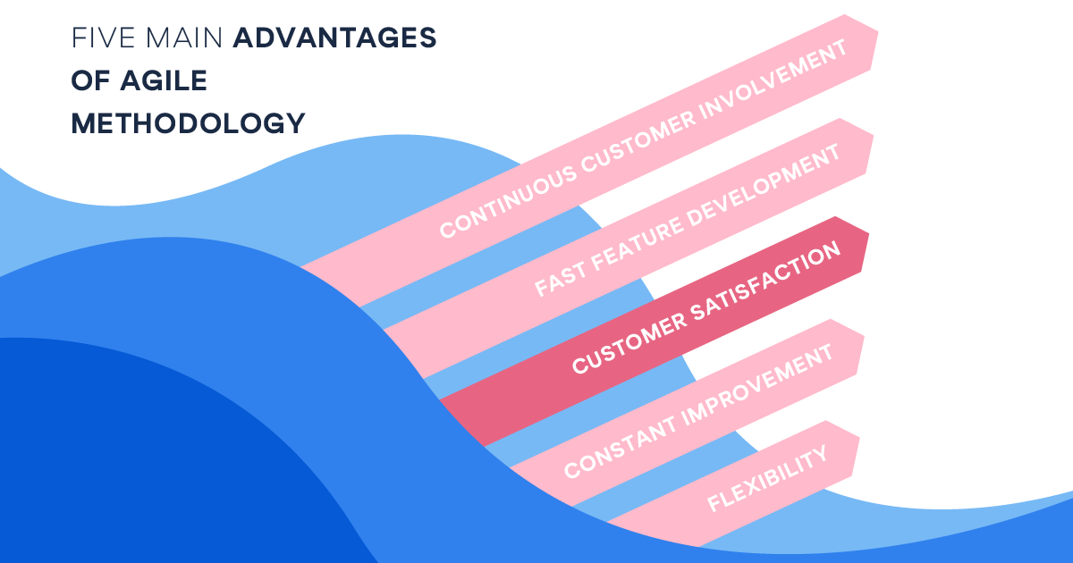
Advantages of Agile Methodology:
Customer satisfaction is rapid, continuous development and delivery of useful software.
Customer, Developer, and Product Owner interact regularly to emphasize rather than processes and tools.
Product is developed fast and frequently delivered (weeks rather than months.)
A face-to-face conversation is the best form of communication.
It continuously gave attention to technical excellence and good design.
Daily and close cooperation between businesspeople and developers.
Regular adaptation to changing circumstances.
Even late changes in requirements are welcomed.

Slide 13
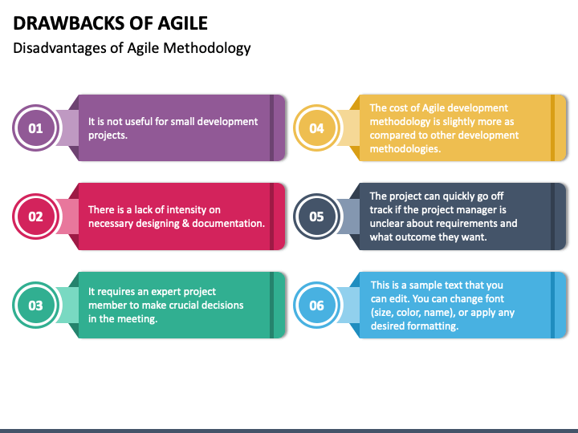
Disadvantages of Agile methodology:
It is not useful for small development projects.
There is a lack of intensity on necessary designing and documentation.
It requires an expert project member to take crucial decisions in the meeting.
Cost of Agile development methodology is slightly more as compared to other development methodology.
The project can quickly go out off track if the project manager is not clear about requirements and what outcome he/she wants.

Slide 14

AGILE MANIFESTO

Slide 15

AGILE MANIFESTO
We are uncovering the better ways of developing software by doing it and helping others to do it. Through this meeting, we have come to value -
Individuals and interactions over Processes and tools.
Working software over comprehensive documentation.
Customers are collaboration over contact negotiation.
Responding to change over following a plan.
So that, while there is value in the items on the right, we value the items on the left more.

Slide 16

PRINCIPLES OF AGILE MANIFESTO

Slide 17
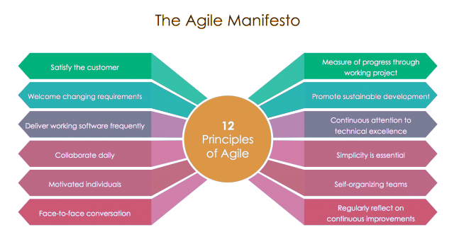
PRINCIPLES OF AGILE MANIFESTO
There are 12 principles in agile manifesto. They are:
Customer Satisfaction
Welcome Change
Deliver the Working Software
Collaboration
Motivation
Face-to-face Conversation
Measure the Progress as per the Working Software
Maintain Constant Pace
Monitoring
Simplicity
Self-organized Teams
Review the Work Regularly

Slide 18
The Twelve Principle of Agile Manifesto:
Customer Satisfaction:
Manifesto provides high priority to satisfy the costumer's requirements. This is done through early and continuous delivery of valuable software.
2.Welcome Change:
Making changes during software development is common and inevitable. Every changing requirement should be welcome, even in the late development phase. Agile process works to increase the customers' competitive advantage.
3.Deliver the Working Software:
Deliver the working software frequently, ranging from a few weeks to a few months with considering the shortest timeperiod.

Slide 19
4.Collaboration:
Businesspeople (Scrum Master and Project Owner) and developers must work together during the entire life of a project development phase.
5.Motivation:
Projects should be build around motivated team members. Provide such environment that supports individual team members and trust them. It makes them feel responsible for getting the job done thoroughly.
6.Face-to-face Conversation:
Face-to-face conversation between Scrum Master and development team and between the Scrum Master and customers for the most efficient and effective method of conveying information to and within a development team.

Slide 20
7.Measure the Progress as per the Working Software:
The working software is the key and primary measure of the progress.
8.Maintain Constant Pace:
The aim of agile development is sustainable development. All the businesses and users should be able to maintain a constant pace with the project.
9.Monitoring:
Pay regular attention to technical excellence and good design to maximize agility.

Slide 21
10.Simplicity:
Keep things simple and use simple terms to measure the work that is not completed.
11.Self-organized Teams:
The Agile team should be self-organized. They should not be depending heavily on other teams because the best architectures, requirements, and designs emerge from self-organized teams.
12.Review the Work Regularly:
The work should be reviewed at regular intervals, so that the team can reflect on how to become more productive and adjust its behavior accordingly.

Slide 22

AGILE CHARACTERISTIC

Slide 23
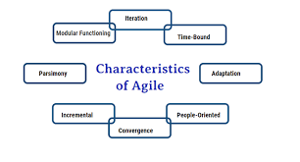
AGILE CHARACTERISTIC
Characteristics of agile development success:
Agile development releases and fixed-length iterations.
Agile development delivers working, tested software.
Value-driven development.
Continuous (adaptive) planning.
Multi-level planning in agile development.
Relative estimation.
Emergent feature discovery.
Continuous testing.

Slide 24


Slide 25
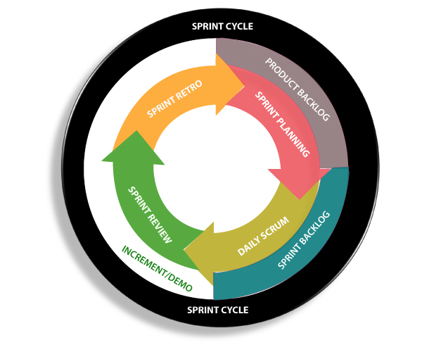

SCRUM
Scrum is a framework that helps agile teams to work together.
Using it, the team members can deliver and sustain the complex product.
It encourages the team to learn through practice, self-organize while working on the problem.
Scum is a work done through the framework and continuously shipping values to customers.
It is the most frequent software that is used by the development team.
Its principle and lessons can be applied to all kinds of teamwork.
Its policy and experiences is a reason of popularity of Scrum framework.
The Scrum describes a set of tools, meetings, and roles that help the teams structure.
It also manages the work done by the team.

Slide 26

KANBAN

Slide 27
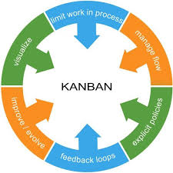
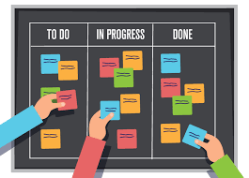
KANBAN
Kanban is a popular framework which is used to implement agile software development.
It takes real time communication of capacity and complete transparency of work.
The work items are represented in a Kanban board visually, allowing team members to see the state of every piece of work at any time.
This is known as Kanban.

Slide 28
PRINCIPLE OF KANBAN

Slide 29
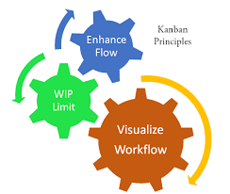
PRINCIPLE OF KANBAN
There are four principles in Kanban. They are :
Visualize workflow
WIP (work in progress)
Focus on the flow
Continues increment

Slide 30
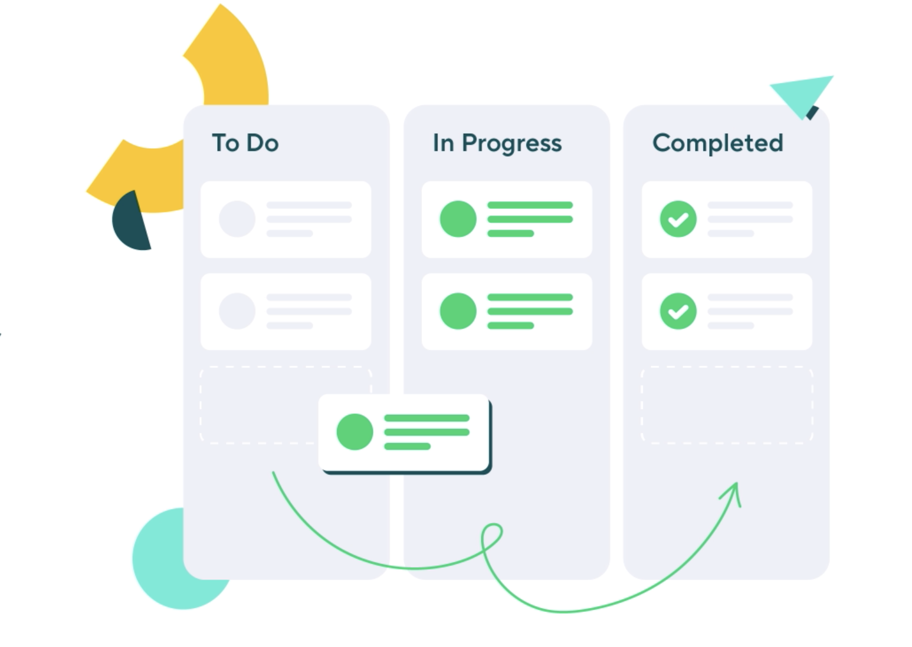
Visualize workflow:
In its simplest form a Kanban board features three stages:
To-Do
In Progress
Completed
You can add more stages to best serve a particular process too. For example, adding a ‘Review’ stage between In Progress and Done.
The sequence across the stages is referred to as the workflow. It starts with discovery activities (eg. a request being made) and ends with delivery — the feature that has been completed and delivered back to the customer.

Slide 31
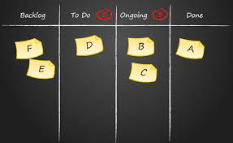
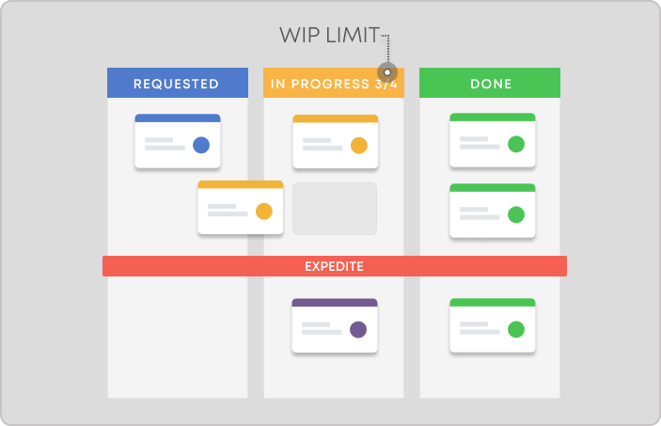
2. WIP (work in progress):
Limiting WIP ensures that at any point in time there is never too much or too little work to do.
You want to have just the right number of cards on a Kanban board that can be handled by resources available.
This is achieved by implementing a pull system where new work is only ‘pulled’ in when there is enough capacity to handle it.
For this to work, limits to WIP need to be set and adjusted.
For example, to have a team of 20 engineers and operators build 10 cars a week.

Slide 32
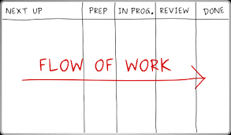
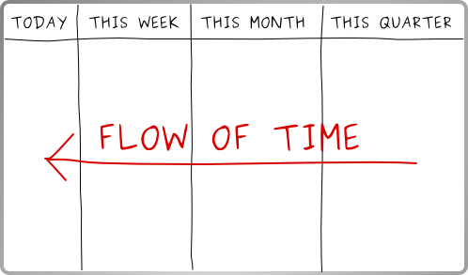
3.Focus on the flow:
The third principle pertains to focusing on the flow of production and the process.
The Kanban board implemented in the first step provides a great tool to observe how work is moving from one operation to the next.
This will highlight any potential bottlenecks and allow managers to focus on interruptions in the normal flow.

Slide 33

4.Continues increment:
The last principle of Kanban is continuous improvement.
This is a common theme in most lean manufacturing methods.
Unless you are operating at maximum efficiency, you will need to keep improving.
As you start implementing Kanban and lean manufacturing principles within your operations, you will need to adjust to keep this improvement.

Slide 34

EXTREME PROGRAMMING

Slide 35

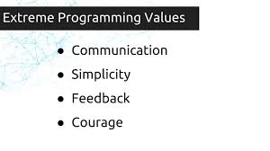
EXTREME PROGRAMMING
XP sets out to lower the cost of change by introducing basic values, principles and practices.
By applying XP, a system development project should be more flexible with respect to changes.
There are some value and principles in this extreme programming.
This is known as extreme programming.

Slide 36

VALUES OF EXTREME PROGRAMMING

Slide 37
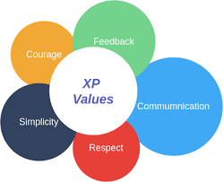
VALUES OF EXTREME PROGRAMMING
Extreme Programming (XP) is based on the five values −
Communication
Simplicity
Feedback
Courage
Respect

Slide 38

Communication:
Communication plays a major role in the success of a project.
Problems with projects often arise due to lack of communication.
Many circumstances may lead to the breakdown in communication.
Some of the common problems are −
A developer may not tell someone else about a critical change in the design.
A developer may not ask the customer the right questions, and so a critical domain decision is blown.
A manager may not ask a developer the right question, and project progress is misreported.
A developer may ignore something important conveyed by the customer.

Slide 39

Simplicity:
Extreme Programming believes in ‘it is better to do a simple thing today and pay a little more tomorrow to change it’ than ‘to do a more complicated thing today that may never be used anyway’.
Take small simple steps to your goal and mitigate failures as they happen.
Create something that you are proud of and maintain it for a long term for reasonable costs.
Never implement a feature you do not need now i.e. the ‘You Aren’t Going to Need It’ (YAGNI) principle.
Communication and Simplicity support each other.
The simpler your system is, the less you have to communicate about the fewer developers that you require.
This leads to better communication.

Slide 40
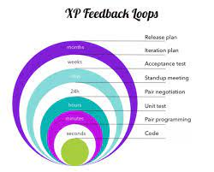
Feedback:
Customers tell the developers what features they are interested in so that the developers can focus only on those features.
Unit tests tell the developers the status of the system.
The system and the code provides feedback on the state of development to the managers, stakeholders and the customers.
Frequent releases enable the customer to perform acceptance tests and provide feedback and developers to work based on that feedback.
When the customers write new features/user stories, the developers estimate the time required to deliver the changes, to set the expectations with the customer and managers.
Thus, in Extreme Programming the feedback −
Works as a catalyst for change
Indicates progress
Gives confidence to the developers that they are on the right track

Slide 41


Courage:
Extreme Programming provides courage to the developers in the following way −
To focus on only what is required
To communicate and accept feedback
To tell the truth about progress and estimates
To refactor the code
To adapt to changes whenever they happen
To throw the code away (prototypes)
This is possible as no one is working alone and the coach guides the team continuously.
Respect:
Respect is a deep value, one that lies below the surface of the other four values. In Extreme Programming,
Everyone respects each other as a valued team member.
Everyone contributes value such as enthusiasm.
Developers respect the expertise of the customers and vice versa.
Management respects the right of the developers to accept the responsibility and receive authority over their own work.
Combined with communication, simplicity, and concrete feedback, courage becomes extremely valuable.

Slide 42

PRINCIPLE OF EXTREME PROGRAMMING

Slide 43
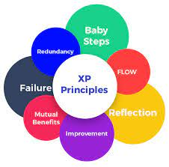
PRINCIPLE OF EXTREME PROGRAMMING
The fundamental principles of Extreme Programming are −
Rapid feedback
Assume simplicity
Incremental change
Embracing change
Quality work

Slide 44
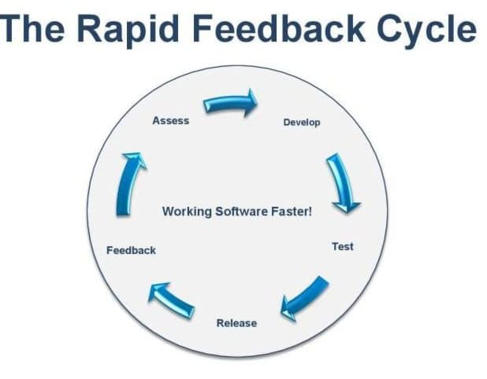
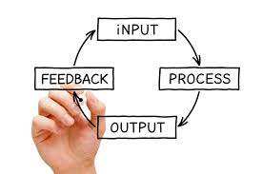
Rapid Feedback:
Rapid feedback is to get the feedback, understand it, and put the learning back into the system as quickly as possible.
The developers design, implement and test the system, and use that feedback in seconds or minutes instead of days, weeks, or months.
The customers review the system to check how best it can contribute, and give feedback in days or weeks instead of months or years.

Slide 45
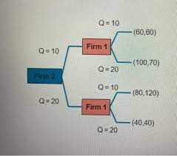
Assume Simplicity:
To assume simplicity is to treat every problem as if it can be solved with simplicity.
‘Assume Simplicity’ means ‘do a good job of solving today's job today and trust your ability to add complexity in the future where you need it.’
In Extreme Programming, you are told to do a good job (tests, refactoring, and communication) focusing on what is important today.

Slide 46

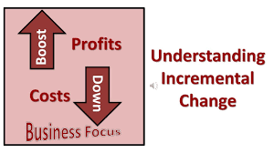
Incremental Change:
In any situation, big changes made all at once just do not work. Any problem is solved with a series of the smallest change that makes a difference.
In Extreme Programming, Incremental Change is applied in many ways.
The design changes a little at a time.
The plan changes a little at a time.
The team changes a little at a time.
Even the adoption of Extreme Programming must be taken in little steps.

Slide 47


Embracing Change:
The best strategy is the one that preserves the
most options while solving your most pressing problem.
Quality Work:
Everyone likes doing a good job. They try to produce the quality
that they are proud of. The team
Works well
Enjoys the work
Feels good in producing a product of value

Slide 48


